Slide 1
Churn Prediction Model
Team:
- Nikhil Dhapodkar
- Sunaina Mallipedi

Slide 2
Overview
Introduction
Brief on the project
Objective
Problem statement
Data available
Tools Used
Methodology
Result
Conclusion

Slide 3
Brief on the Project
Churn?
Churn Rate?
Churn Management?

Slide 4
Objective
Prevent Churn
To find an efficient and accurate predictive model for customer churn in telecommunication
Utilizing machine learning techniques
Increase Customer Satisfaction
Understand why particular customers churn
Capture Revenue

Slide 5
Problem statement
Churn in Telecom service is actually measure base on the lack of activity in the network over a period time, thus there is no formal notification from customer of ending a contract term, our goal is to infer when this lack of activity may happen in the future for each active customer.

Slide 6
Data Available
Voice Usage: Incoming / Outgoing Minutes of Usage for Local calls , STD calls, ISD calls, Local to other networks, STD to other networks, ISD to other networks.
Data Usage: 2G in MB 3G in MB
Payment data: Monthly Payment Data Total Bill, Rental Charge, Non Rental Charge
Subscriber information: Customer Type Account activation date Disconnection date (If
Customer care data Call to Customer Care Call type (Request / Query / Complaint / Feedback)
Successive calls to customer care

Slide 7
Tools Used
Python, R, Rhadoop
- Pre Processing of Data
- Processing of Data
MS Word
- Report Creation
- ROC Curve
MS Excel
- Database

Slide 8
Methodology
Data Cleaning (Pre Processing) - Python
Libraries Imported
Defined Functions
Fetching Data and Cleaning
Merging of data
Single View

Slide 9
Processing using R and Rhadoop on the server
Libraries Imported
Reading Single View file and changing the date format
Deriving Variables
Separating the required variables
Reading Disconnection data and changing the date format
Merging the files
Writing and Reading the merged file
Logistic Regression

Slide 10
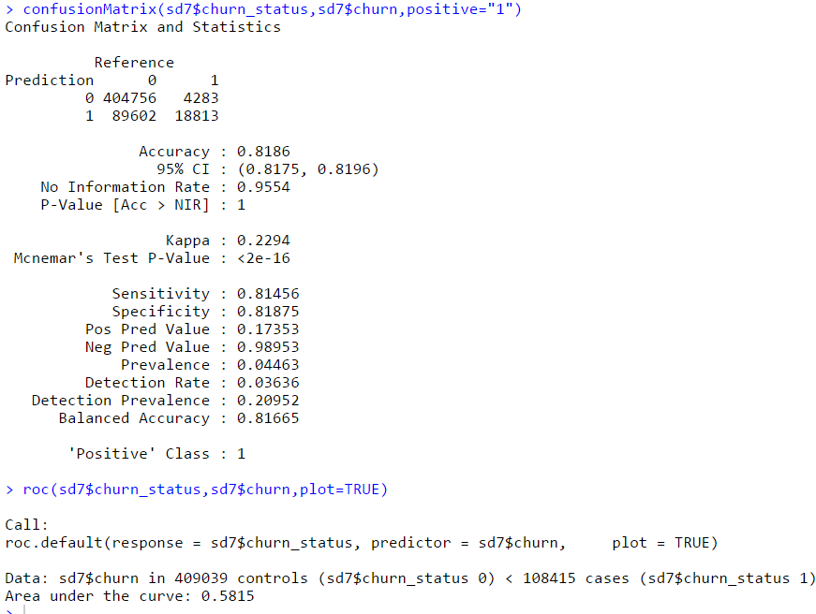
Result (Confusion Matrix)

Slide 11
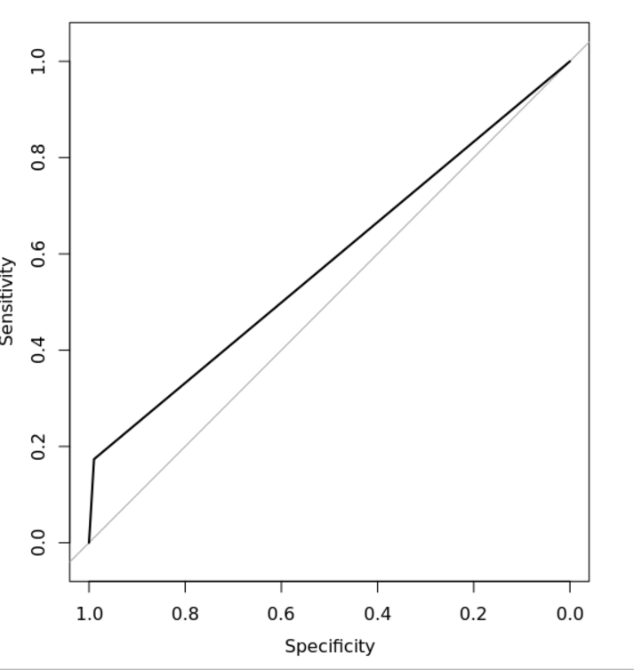
Result (ROC Curve)

Slide 12
Conclusion
Retention approach is based on combining customer churn prediction.
Thus goes beyond “actionable customer analytics” to automatically determine exactly what kind of action should be run for each at-risk customer to achieve the maximum degree of retention possible.
In order to reduce the various costs associated with customer churn, it is imperative that mobile service providers deploy churn predictive models that can reliably identify customers who are about to leave. After the possible churners are identified, intervention strategies should be put in place with the aim of retaining as many customers as possible.
In case of logistic regression model, the user should update the model to be able to produce predictions with high accuracy.

Slide 13
Thank You

